Slide 1
GAME DEVELOPMENT
Yaser alosh

Slide 2
SUB FIELDS
Artistic and Technical
Animation. Programming. Math. Physics. AI.
Game design. 2D-3D Art. Audio. VFX.
Game design. 2D-3D Art. Audio. VFX.

Slide 3
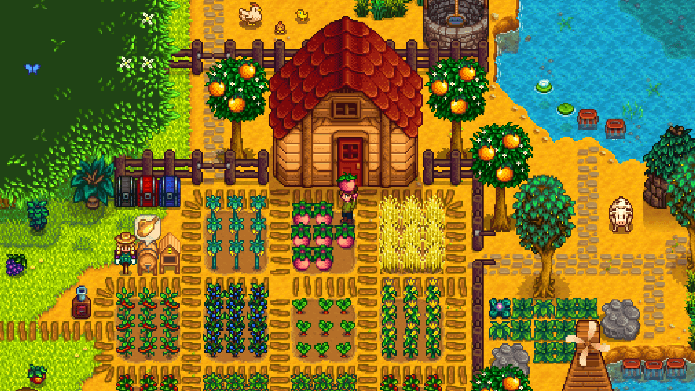
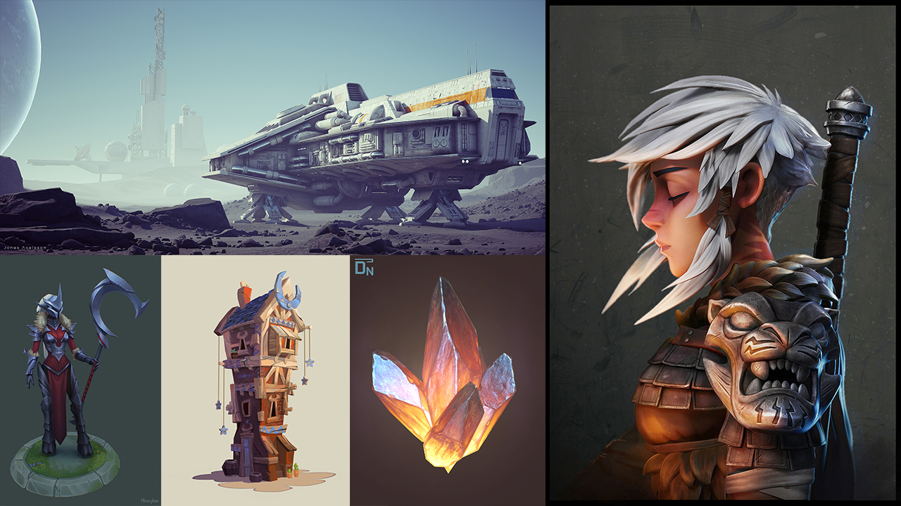
Artistic and Technical
Stardew valley

Slide 4
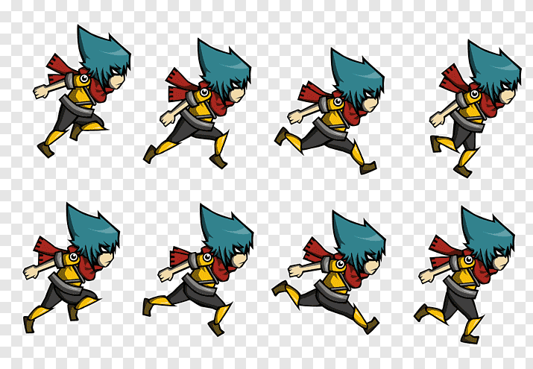
Animation. Programming. Math. Physics. AI.

Slide 5
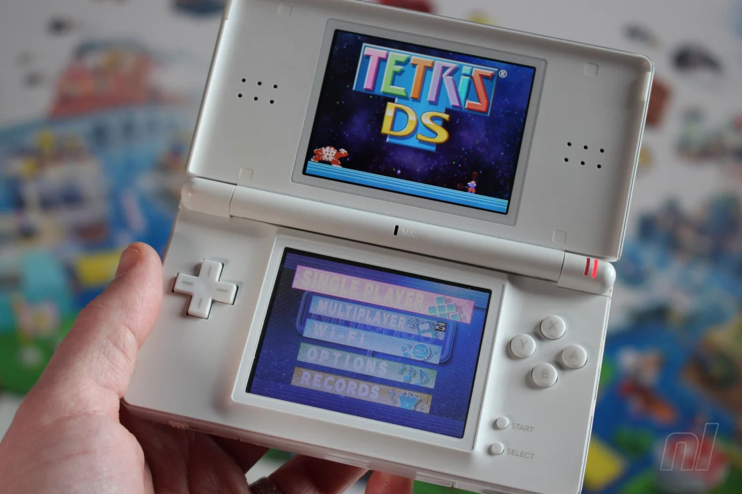
How I got into Game Development.

Slide 6
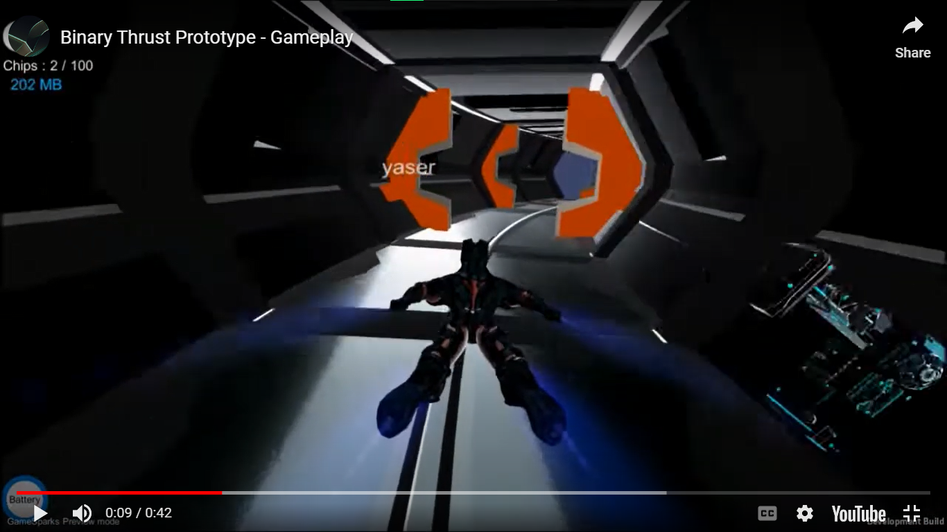
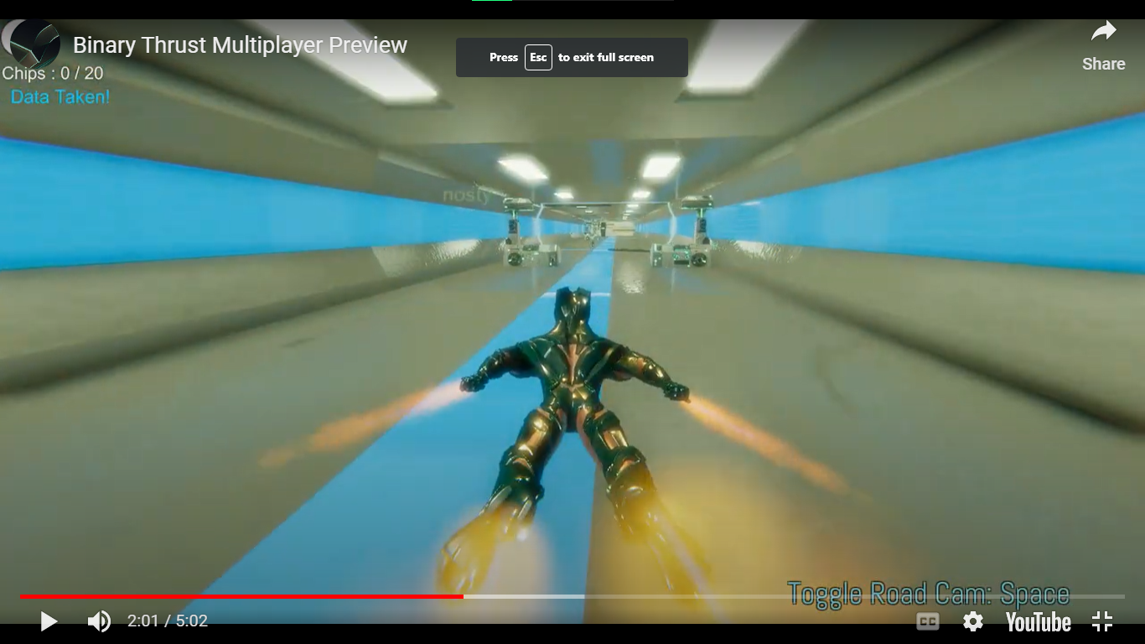
My first game and my first indie team.

Slide 7
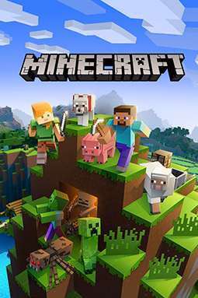
A game from a concept to a product
Ideation
Prototyping
Feedback
Art
Full Functionality
Testing
Marketing
Publishing

Slide 8
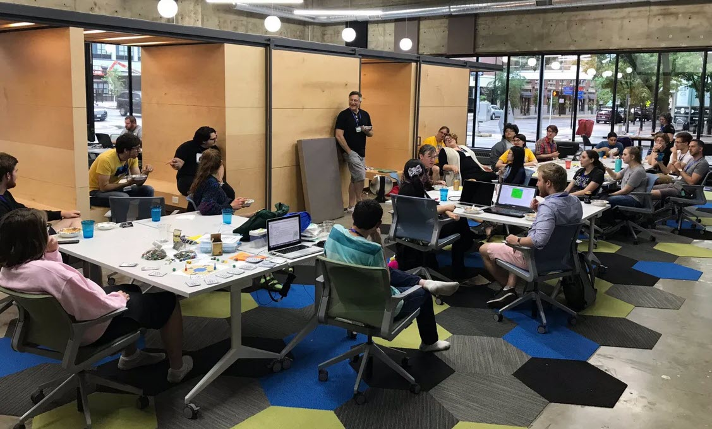
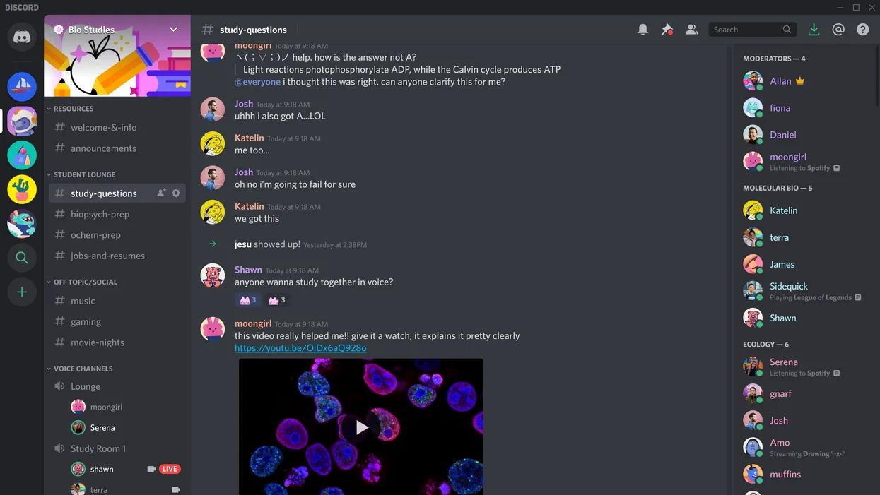
Ways to start
Game Jams
Find teammates
Pitch to publishers

Slide 9
How can you create great games on your own?
Use Game Engines

Slide 10
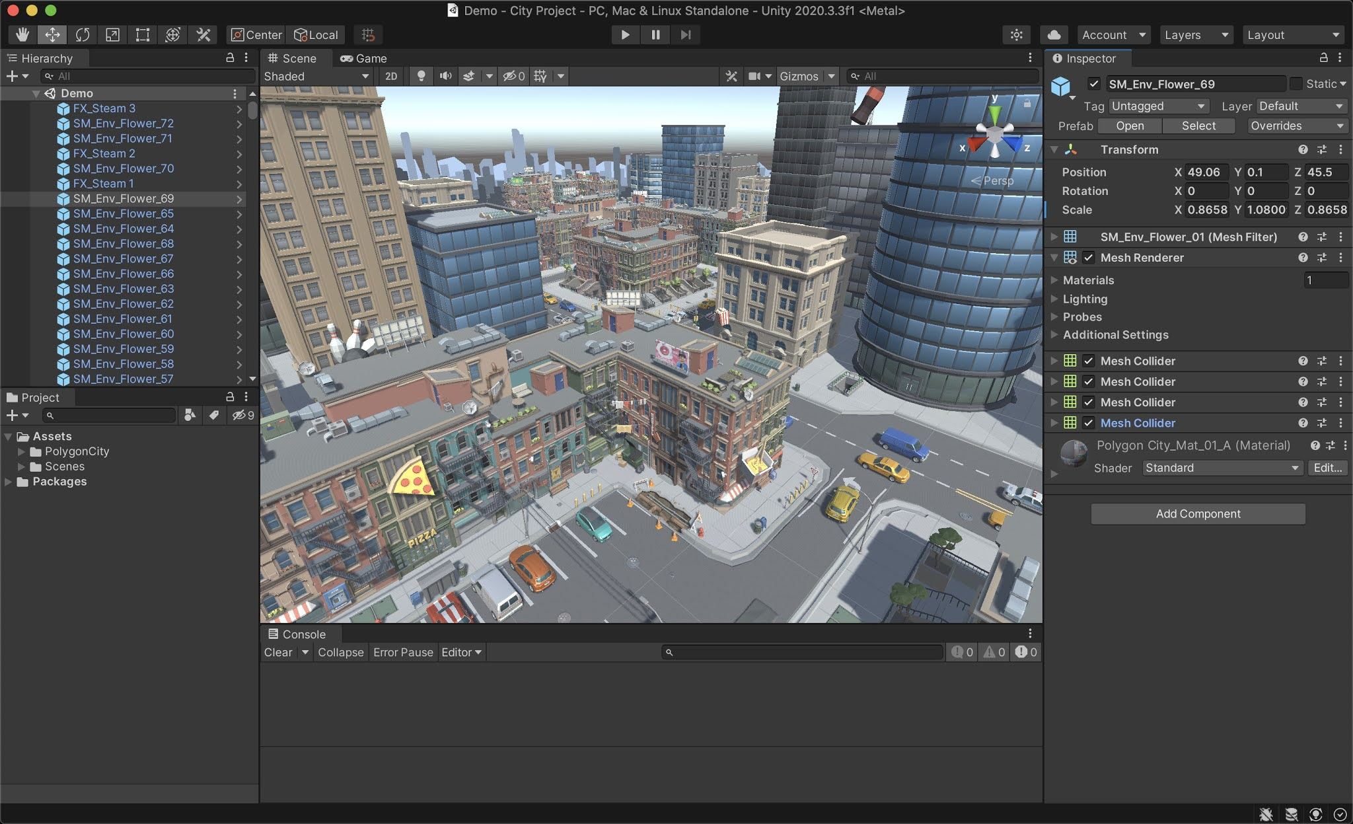
Game Engines - Unity

Slide 11
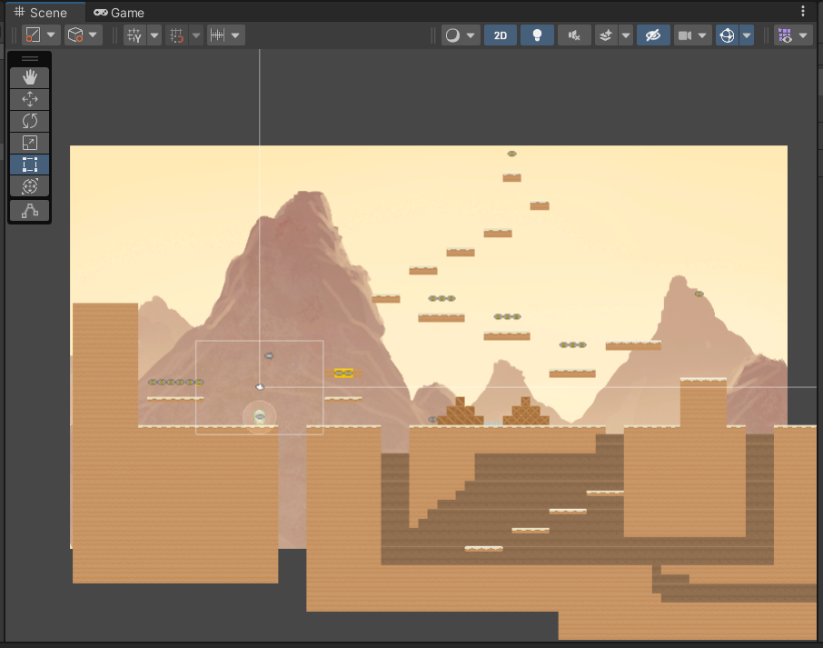
The scene
Every game made in Unity is composed of Scenes.
You might have one scene only.
A scene contains all the game objects in your game.
In the editor, you can create your scene easily.

Slide 12
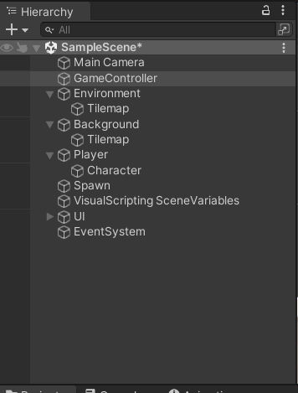
The Hierarchy
The hierarchy holds every gameobject in your scene.
It represents the structure of elements in your scene.
You might select objects, add or remove objects all through this panel.

Slide 13
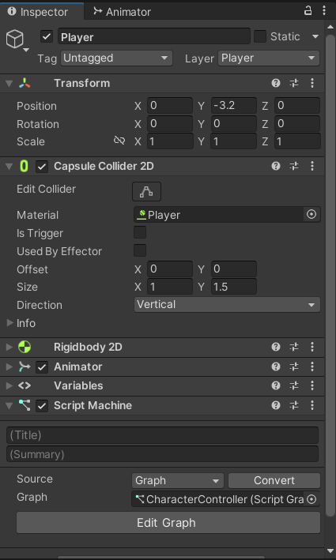
The Inspector
From the inspector you can add and edit the components of your Gameobjects.
Components make up each Game Object.
They define the behavior of them.

Slide 14
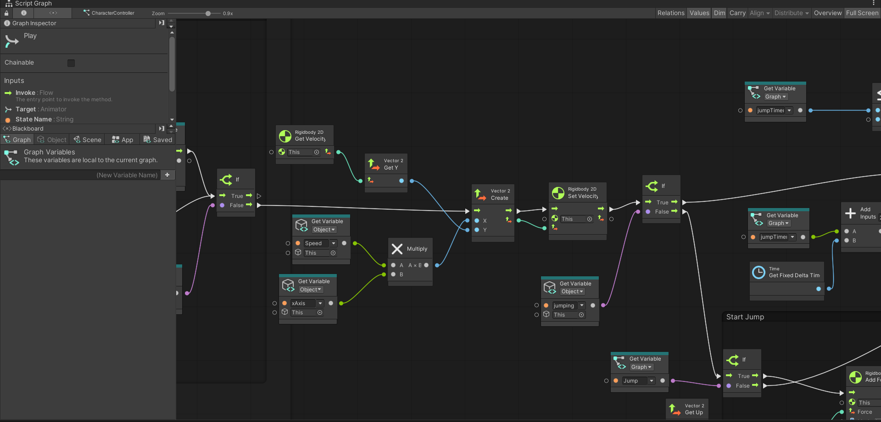
Visual Scripting
Usually in Unity we code with C#.
But in the workshop today, we will use the visual scripting functionality introduced in Unity Version 2021.

Slide 15
THANK YOU ☺

